Slide 1
Big Data Analytics Symposium - Summer 2020
Analytics Project: Traditional vs. Advanced Statistics and the NBA Regular Season MVP Award
Team:
Alex Spence (ajs811)
Mike Urciuoli (mlu216)

Slide 2
Traditional vs. Advanced Statistics and the NBA Regular Season MVP Award
Abstract:
Traditional NBA player statistics have been collected since the onset of the NBA in 1946. The development of advanced player statistics have grown in the NBA from the 1990s through today. This project looks to answer the question which statistics (advanced or traditional) correlate most to the regular season MVP award. The seasons used for comparison were 2002-03 to 2016-17. It was determined that on average, the metrics which most correlated to the regular season MVP were estimated wins added, value added and player efficiency rating (all advanced statistics). For further study, it is recommended to analyze more seasons and apply machine learning techniques on the most informative statistics to develop regular season MVP prediction models.
Platform(s) where the application runs:
< NYU Dumbo (Hadoop MapReduce, Apache Impala)>

Slide 3
Traditional vs. Advanced Statistics and the NBA Regular Season MVP Award
Motivation
Who are the users of this analytic?
NBA franchises and players, and the media
Who will benefit from this analytic?
same as above, plus NBA fans
Why is this analytic important?
This analytic is important to provide an objective assessment of player performance as it relates to the regular season MVP, and to determine which statistics are most informative.

Slide 4
Traditional vs. Advanced Statistics and the NBA Regular Season MVP Award
Goodness
What steps were taken to assess the ‘goodness’ of the analytic?
The results of our analytic are correct and can be trusted because we are performing simple statistics and rankings of typical player statistics per season. This data is readily available on sources such as ESPN.com and NBA.com and was used to spot check the calculations. In addition, domain knowledge and the results of the data profiling were used to assess the goodness of the analytic. We also predicted the mvp winners for each season based on the results of the analytic.

Slide 5
Traditional vs. Advanced Statistics and the NBA Regular Season MVP Award
Data Sources
Name: Advanced Player Statistics (2002-03 to 2017-18)
Description: NBA advanced player statistics organized by season such as PER, EWA, TS%
Size of data: 0.6 MB
Name: Traditional Player Statistics (1949-50 to 2016-17)
Description: NBA traditional player statistics organized by season such as pts, rbs, asts
Size of data: 5.1 MB
Name: Regular Season MVPs (1949-50 to 2018-19(
Description: NBA MVPs organized by season
Size of data: 4 KB

Slide 6
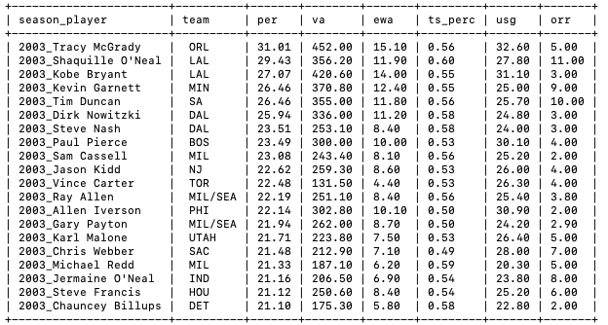
Traditional vs. Advanced Statistics and the NBA Regular Season MVP Award
Data Sample: Advanced Player Statistics

Slide 7
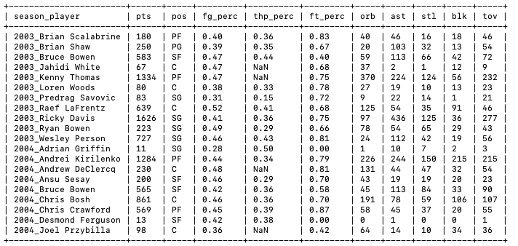
Traditional vs. Advanced Statistics and the NBA Regular Season MVP Award
Data Sample: Traditional Player Statistics

Slide 8
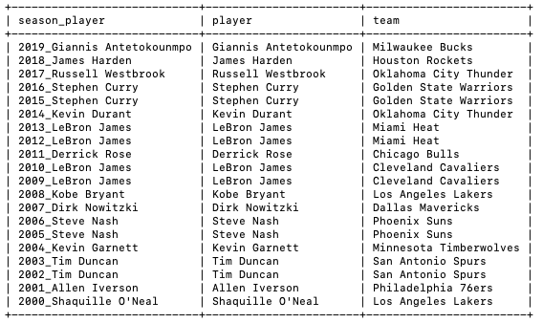
Traditional vs. Advanced Statistics and the NBA Regular Season MVP Award
Data Sample: Regular Season MVPs

Slide 9
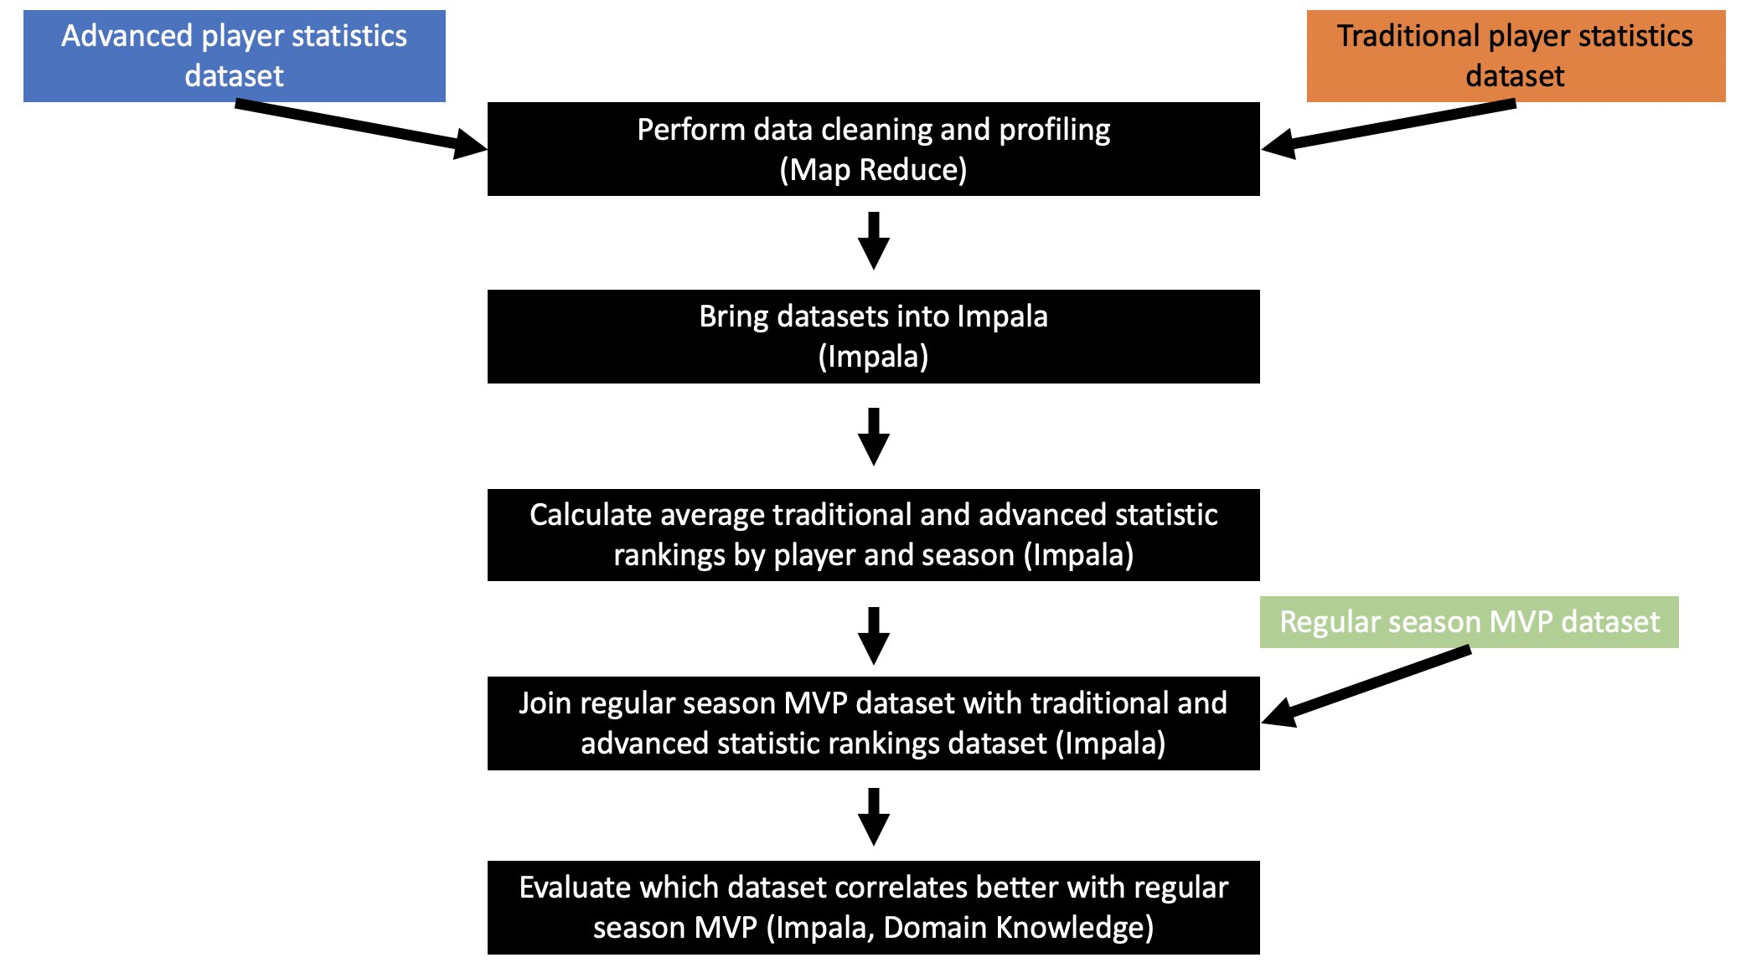
Traditional vs. Advanced Statistics and the NBA Regular Season MVP Award
Design Diagram

Slide 10
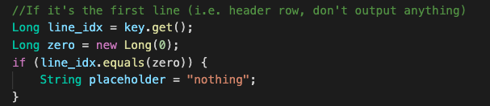
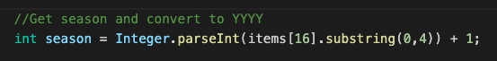
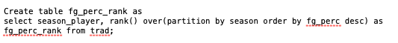
Traditional vs. Advanced Statistics and the NBA Regular Season MVP Award
Code Challenge 1 (Alex)
MapReduce (Cleaning)
Ignoring the header row of data
Converting YYY1-YYY2 to YYY2
Impala (Developing Analytic)
Develop rank code
Staying organized with long queries with many columns and joins (see next page)!

Slide 11
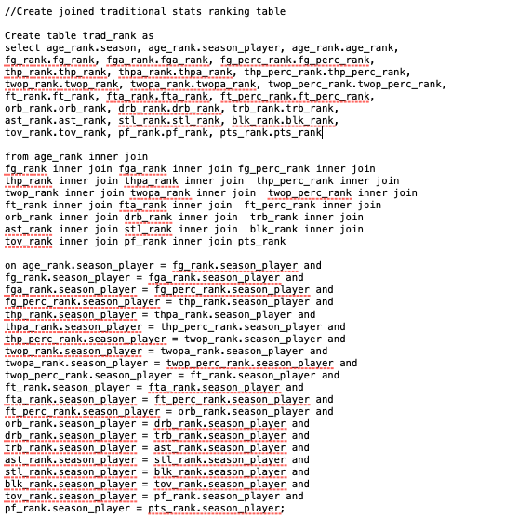
Traditional vs. Advanced Statistics and the NBA Regular Season MVP Award
Code Challenge 1 (Alex)
Impala
Staying organized with long join queries after ranking!

Slide 12
Traditional vs. Advanced Statistics and the NBA Regular Season MVP Award
Code Challenge 2 (Mike)
<Show some interesting algorithms/code you wrote, or some coding challenge you had to overcome. There should be one Code Challenge slide per team member. >

Slide 13
Traditional vs. Advanced Statistics and the NBA Regular Season MVP Award
Results definitions
Advanced Statistics:
ewa: estimated wins added
va: value added
per: player efficiency rating
usg : usage rating
ts_perc: true shooting %
Traditional Statistics:
pts: points
fg: field goals made
tov: turnovers
ft: free throws made
ast: assists

Slide 14
Traditional vs. Advanced Statistics and the NBA Regular Season MVP Award
Results
1. Most informative advanced statistics by avg mvp ranks:
ewa (3.8) / va (3.8) / per (4.1) / usg (10.6) / ts_perc (35.9)
2. Most informative traditional statistics by avg mvp ranks:
pts (12.6) / fg (12.67) / tov (15.2) / ft (17.1) / ast (17.6)
3. Composite advanced statistics are the most informative overall
(ewa, va, per)

Slide 15
Traditional vs. Advanced Statistics and the NBA Regular Season MVP Award
Results
4. Advanced statistics seem to be valued less in earlier years
2003 to 2010 avg MVP ewa (5.75 rank / 593 value)
2009 to 2017 avg MVP ewa (1.67 rank / 810 value)
2012 to 2018 MVP ewa rank is 1 for 5/7 seasons
5. 2005 and 2006 has the lowest ranked ewa MVPs
Steve Nash (18 rank, 15 rank)
6. Using avg rank of ewa, va, and per accurately predicts the mvp in 10/16 seasons from 2003 to 2018 (see next slide)

Slide 16
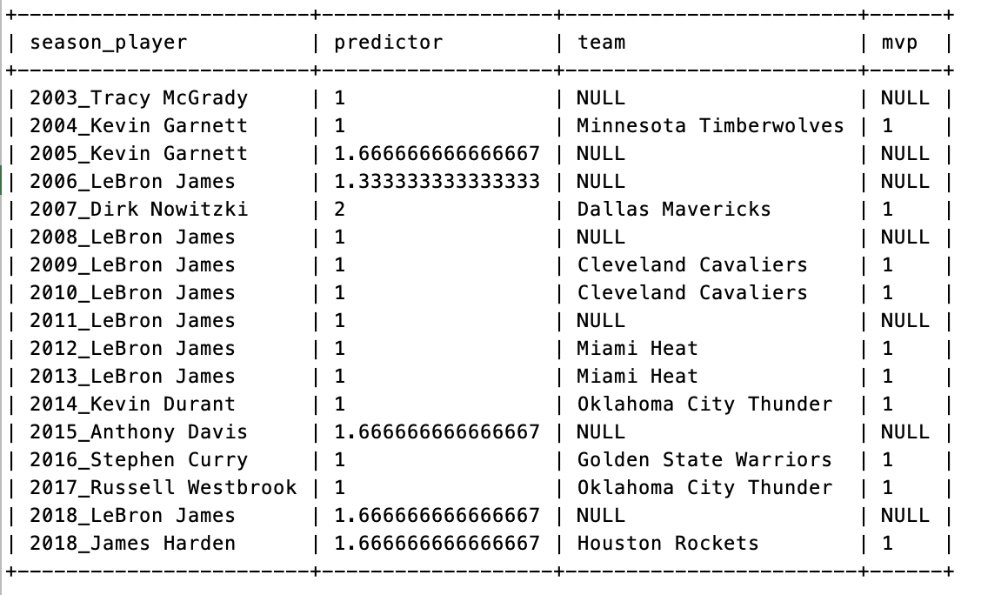
Traditional vs. Advanced Statistics and the NBA Regular Season MVP Award
Results

Slide 17
Traditional vs. Advanced Statistics and the NBA Regular Season MVP Award
Obstacles
1. More players provided in traditional than advanced dataset per year. We solved this by treating the datasets independently, then joining on the mvp dataset for final average rank calculations.
2. Distinguishing between string and integer fields in the profile reducer (solved with a try and except)
3. Connecting Impala tables to Tableau (this can be looked at further in a future study)

Slide 18
Traditional vs. Advanced Statistics and the NBA Regular Season MVP Award
Summary
MapReduce and Impala were used to develop an analytic to compare traditional and advanced statistics and evaluate the correlation to the regular season mvp award.
Seasons: 2002-03 to 2016-17
Advanced statistics which correlated most with regular season MVP were ewa, va, and per
Traditional statistics which correlated most with regular season MVP were pts, fg, and tov
Future work recommendations / areas for further study:
Include more years using NBA API or Basketball-Reference API
Develop machine learning code with the most informative statistics to predict regular season MVP future
Develop Tableau visualizations
Areas for future study:
Develop analytics for other awards (Defensive player of the year, All NBA Teams, Rookie of the Year, etc.)

Slide 19
Traditional vs. Advanced Statistics and the NBA Regular Season MVP Award
Acknowledgements
Thank you to Prof. McIntosh for answering our analysis questions.
Thank you to Kaggle for compiling the data sets.
Thank you to HPC for providing the technology to make this project possible.
Thank you to the NBA for providing a medium for professional basketball.

Slide 20
Traditional vs. Advanced Statistics and the NBA Regular Season MVP Award
References
A Neural Network Model of the NBA Most Valued Player Selection Prediction (Chen, Dai, Zhang) link
Key Game Indicators in NBA Players’ Performance Profiles (Dehesa, Vaquera, Goncalves, Mateus, Gomez-Ruano, Sampaio) link
Predicting Per Game Performance Through Per Minute Performance in Basketball (Martinez) link
Mike
Mike
Mike

Slide 21
Traditional vs. Advanced Statistics and the NBA Regular Season MVP Award
Thank you!

